Slide 1

Python
TECHMONTH 2017
SIM IT CLUB
(Pavithran)

Slide 2
About Python
Interpreted
Python code can be processed and executed at runtime by the interpreter without the need to compile the program
Interactive
You can type code commands in the Python Command Prompt and interpret with the interpreter directly to type your commands
Object-Oriented
Supports Object-Oriented programming and encapsulation of code within objects
Notes:
Interpreted -> compare JVM with Python Interpreter
Interactive -> Since the participants are using Spyder, they can interact with the IDE itself

Slide 3
ABOUT python
Beginner’s Language
Python code syntax is easy-to-read
Most paid and on high-demand in the job market
Python is capable of supporting the development of a wide range of applications, from simple text processing, to web, desktop and mobile apps and games.
Python is widely used in the following applications today:
Machine Learning
Data Science and Data Analytics
Computer Vision
Notes:
Beginner’s language – for those who have no coding experience but interested to learn how to code, Python is the best choice for a start
Most paid and on high-demand – being familiar with python is a great advantage when looking for a job in the IT or analytics sector

Slide 4
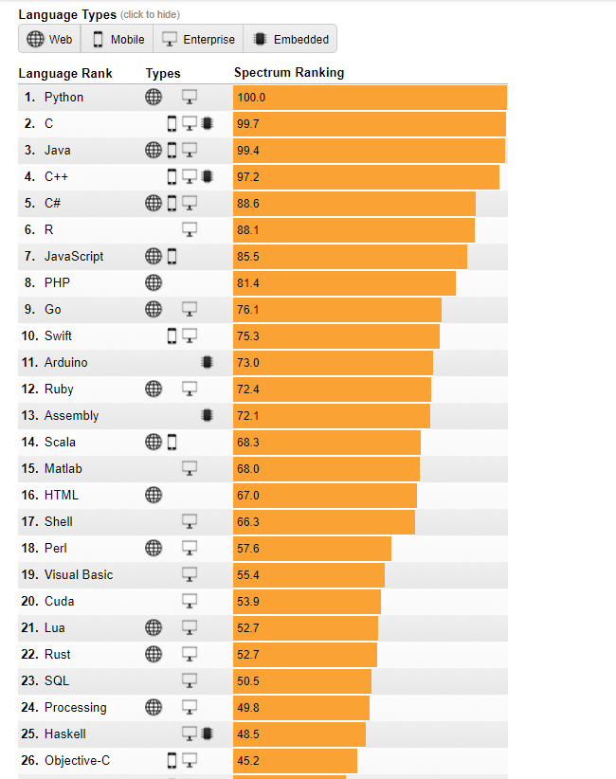
Source:
https://spectrum.ieee.org/static/interactive-the-top-programming-languages-2017
Notes:
For those who are new to programming, you can start of with learning python first.
For those who are already familiar with several programming languages, you can choose to learn one or more of those in the top 5 or 10.

Slide 5
Applications that are built on Python
Google
YouTube
Instagram
Reddit
Dropbox
Spotify
Pinterest
Eventbrite
Notes:
Add verbal words or show visual logo?

Slide 6
Hello world

Slide 7


Program in JAVA
program in
python
print(“Hello World!”)
class HelloWorld
{
public static void main (String[]args)
{
System.out.println(“Hello World!”);
}
}

Slide 8
VARIABLES AND DATA TYpes

Slide 9
Variables and value assignment
No explicit declaration of type required
Declaration is automatic when you assign a value to a variable
Equals operator (=) is used to assign a value to a variable
After assigning a value to a variable, we can identify the data type of the variable using the type() function.
Notes:
Type() function is a built-in function in python

Slide 10
DATa types in python
Python has 5 standard data types:
Numbers
String
List
Tuple
Dictionary

Slide 11
Sample program
number1 = 50 # int
number2 = 50.0 # float
number3 = 1234567890 # int - long numbers are known as int in python 3
number4 = 54 + 2j # complex
sampleString = “abc” # string
print (type(number1))
print (type(number2))
print (type(number3))
print (type(number4))
print (type(sampleString))

Slide 12
Numbers
Python supports 4 different numerical types:
int - signed integers
long – long integers
float – floating point real numbers
- complex – complex numbers

Slide 13
Strings
A set of characters represented in either single or double quotation marks
Use slice operator ([] or [:]) with indices starting at 0 from the start of the string or -1 from the end of the string
Plus sign (+) is used for concatenating strings
Asterisk sign (*) is used for repeating strings

Slide 14
Sample program
sampleString = “Hello World!”
print(sampleString[0]) # H
print(sampleString[1:10]) # ello Worl
print(sampleString[2:]) # llo World!
print(sampleString*2) # Hello World!Hello World!
print(sampleString+“Glad to be here!”) # Hello World!Glad to be here!
print(sampleString+“ Glad to be here!”) # Hello World! Glad to be here!
Notes:
Talk about the index assignments of the string

Slide 15
LISTS
A linear data structure containing items arranged in an order
Has items separated by commas and enclosed in square brackets
The items in a list can be of different data types
Slice operator is used to access elements in the list

Slide 16
Sample program
simpleList = [‘Pavithran’, ‘Kok Wee’, ‘Smit’, ‘Deepali’]
sampleList = [‘Python’, 101017, ‘SIMITC’, 1900]
print sampleList # entire list is printed out
print sampleList[0] # Python
print sampleList[1:3] # [101017, ‘SIMITC’]

Slide 17
TUPLES
Similar to lists
Enclosed in parentheses ()
Read-only data structures – cannot modify any of the elements
Attempting to modify the elements will throw an error

Slide 18
SAMPLE PROGRAM
sampleTuple = (‘Python’, 101017, ‘SIMITC’, 1900)
print (sampleTuple[0]) # Python
print (sampleTuple[1:3]) # (101017, ‘SIMITC’)
sampleTuple[1] = 111017 # throws an error
print(sampleTuple[1])

Slide 19
DICTIONARIES
Consists of key-value pairs
Dictionary key can be a number or a string
Values can be any Python Object
Enclosed by curly braces
Accessed using square braces

Slide 20
SAMPLE program
sampleDict = {‘Name’: ‘Python’ , ‘Date’: 101017, ‘Time’ : 1900 }
print (sampleDict[‘Name’]) # Python
print (sampleDict.keys()) # prints all keys
print (sampleDict.values()) # prints all values

Slide 21
OPerators

Slide 22
ARITHMETIC OPERATORS
Operator | Meaning | Example | Value of x
+ | Addition | x = 10 + 2 | 12
- | Subtraction | x = 10 – 5 | 5
* | Multiplication | x = 10*10 | 100
/ | Division | x = 10 / 2 | 5
% | Modulus | x = 11 % 2 | 1

Slide 23
ASSIgnment OPERATORS
Addition | total += 10 | total = total + 10
Subtraction | total -= 10 | total = total - 10
Multiplication | total *= 10 | total = total * 10
Division | total /= 10 | total = total/10
Modulus | total %= 10 | total = total%10

Slide 24
LOGICAL OPERATORS
Logical Operator | Example | Value
and | true and false true and true false and true false and false | false true false false
or | True or true True or false False or true False or false | true true true false
not | not true not false | false true

Slide 25
SAMPLE PROGRAM
j = 5
print(j>0 and j<10) #true
print(j>0 and j>10) #false
print(j<0 and j>10) #false
print(j>0 or j<10) #true
print(j>0 or j>10) #true
print(j<0 or j>10) #false
print(not(j>0 and j<10)) #false
print(not(j>0 or j>10)) #true

Slide 26
Comparison operators
Assuming a = 10 and b = 20
Operator | Example
== | print(a==b) -> false
!= | print(a != b) -> true
> | print(a > b) -> false
< | print(a < b) -> true
>= | print (a >= b) -> false
<= | print (a <= b) -> true

Slide 27
CONSOLE INPUT AND OUTPUT

Slide 28
input() and eval(input())
Input() returns the input as a string
eval(input()) can be used to evaluate an expression input by the user.
Notes:
Elaborate eval(input())

Slide 29
Conditional selection

Slide 30
if if-else nested if
if condition: <code matching with condition> | if condition1: <code matching with condition1> elif condition2: <code matching with condition2> else: <code not matching with condition1 or condition2> | if condition1: if condition2: <code matching condition1 and condition2> else: <code matching condition1 but not condition2> else: <code not matching condition1>

Slide 31
SAMPLE PROGRAM
number1 = eval(input(“Enter first number : ”))
number2 = eval(input(“Enter second number : ”))
if number1 > number2:
print(“The first number is greater than the second number”)
elif number1 < number2:
print(“The second number is greater than the first number”)
Notes:
Talk a little more about the eval(input()) expression

Slide 32
Loops

Slide 33
A line or multiple lines of code are executed repeatedly.
For loop
While loop
Nested loops

Slide 34
Looping through numbers in a range
for i in range(4):
print (i)
Output : 0
1
2
3

Slide 35
Looping through characters in a string
for character in ‘Python’:
print (character)
Output: P
y
t
h
o
n

Slide 36
Looping through elements in a list
sampleList = [‘Python’, 101017, ‘SIMITC’, 1900]
for detail in sampleList:
print (detail)
Output: Python
101017
SIMITC
1900

Slide 37
WHILE LOOP
count = 0
while (count < 10):
print (“The count is ”+ count)
count += 1
Output: The count is 0
The count is 1
The count is 2
…..
The count is 9
Notes:
Say that the expression

Slide 38
Nested loops
for i in range(5):
for j in range(5):
k = i*j
print (k)

Slide 39
References
https://www.tutorialspoint.com/python3
https://www.youtube.com/channel/UCqrILQNl5Ed9Dz6CGMyvMTQ

